Slide 1
TPC Space Charge Calibration
Xiaohai Jin
Feb 21 2019
Shanghai Institute of Applied Physics

Slide 2
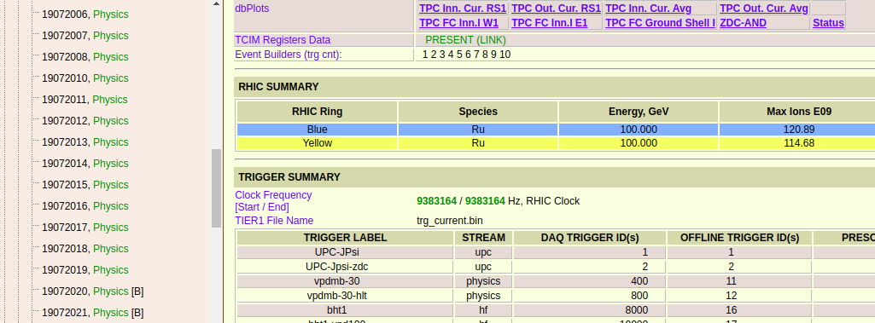
Run Information

Slide 3
Daq File
/star/data03/daq/2018/072/19072018/st_physics_19072018_raw_5000008.daq
/star/data03/daq/2018/072/19072018/st_physics_19072018_raw_3000002.daq
/star/data03/daq/2018/072/19072018/st_physics_19072018_raw_1000008.daq
/star/data03/daq/2018/072/19072017/st_physics_19072017_raw_1000010.daq
/star/data03/daq/2018/072/19072017/st_physics_19072017_raw_5000001.daq
/star/data03/daq/2018/072/19072017/st_physics_19072017_raw_3000001.daq
/star/data03/daq/2018/072/19072014/st_physics_19072014_raw_3000001.daq
/star/data03/daq/2018/072/19072014/st_physics_19072014_raw_1000002.daq
/star/data03/daq/2018/072/19072014/st_physics_19072014_raw_5000001.daq
/star/data03/daq/2018/072/19072015/st_physics_19072015_raw_2500002.daq
/star/data03/daq/2018/072/19072015/st_physics_19072015_raw_5500001.daq
/star/data03/daq/2018/072/19072015/st_physics_19072015_raw_1500001.daq

Slide 4
Daq File
/star/data03/daq/2018/072/19072015/st_physics_19072015_raw_2000001.daq
/star/data03/daq/2018/072/19072015/st_physics_19072015_raw_3500001.daq
/star/data03/daq/2018/072/19072015/st_physics_19072015_raw_4500002.daq
/star/data03/daq/2018/072/19072015/st_physics_19072015_raw_3000002.daq
/star/data03/daq/2018/072/19072015/st_physics_19072015_raw_4000001.daq
/star/data03/daq/2018/072/19072013/st_physics_19072013_raw_1000010.daq
/star/data03/daq/2018/072/19072013/st_physics_19072013_raw_3000001.daq
/star/data03/daq/2018/072/19072013/st_physics_19072013_raw_2000001.daq
/star/data03/daq/2018/072/19072013/st_physics_19072013_raw_4000001.daq
/star/data03/daq/2018/072/19072013/st_physics_19072013_raw_5000009.daq
/star/data03/daq/2018/072/19072015/st_physics_19072015_raw_1000002.daq

Slide 5
Code and Data Directory
Code Directory:
1. /star/u/jhai/SC_GL/submit/submit6.8_9
(Strength of GL between inner/outer sectors is set 14.65)
event.root directory:
1. /star/u/jhai/gpfs01/DATA/Service/SCGL_9

Slide 6
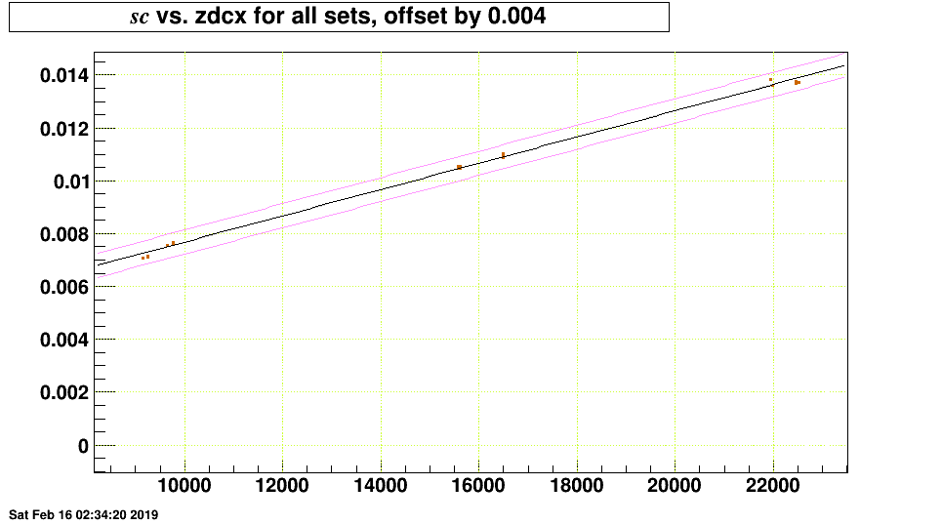
Fitting Result (GL = 14.65)

Slide 7
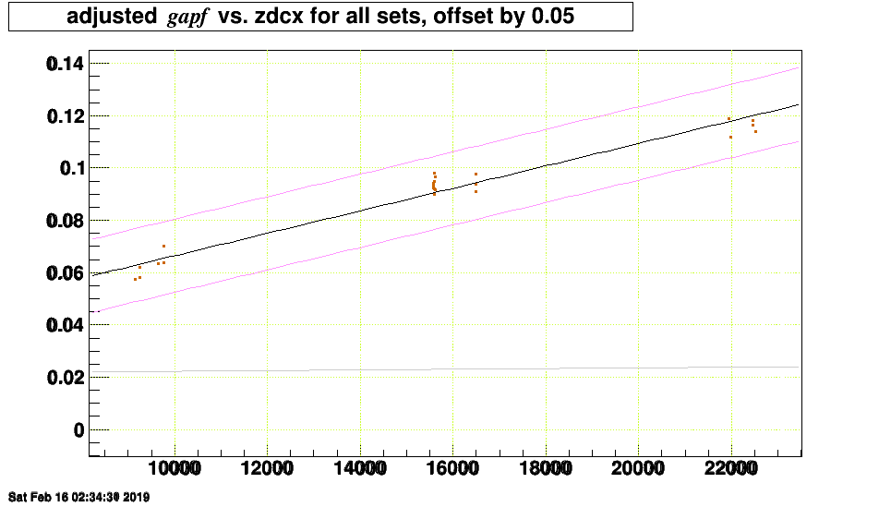
Fitting Result (GL = 14.65)

Slide 8
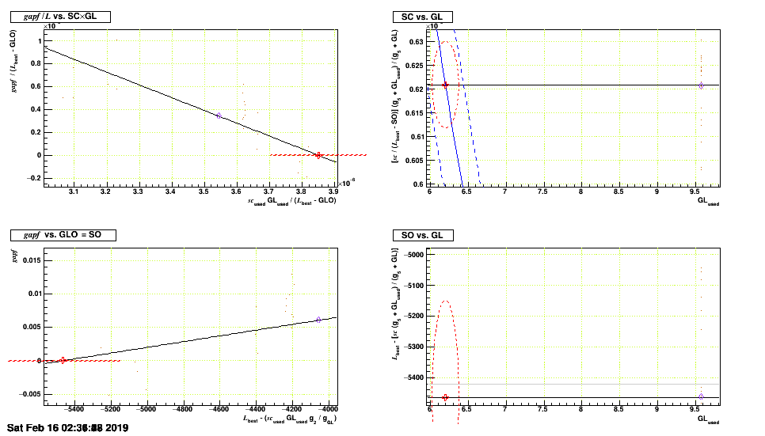
Fitting Result (GL = 14.65)

Slide 9
Fitting Result (GL = 14.65)
sc = (6.209e-07 +/- 9.152e-09) * ((zdcx) - ( -5465 +/- 316.8))
GL = 6.20 +/- 0.18

Slide 10
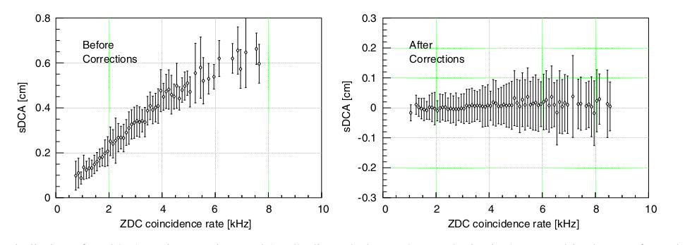
How To Evaluate the Fitting Results?

